Slide 1
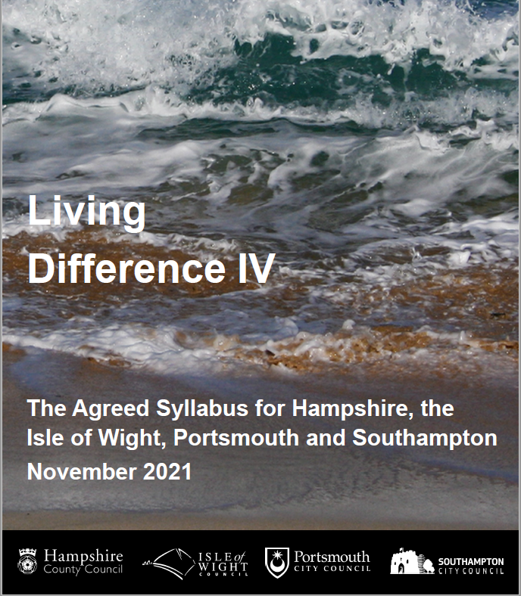
What should RE look like in our school?

Slide 2
What you need to know…
RE in our school follows Living Difference IV, which is the Agreed Syllabus for Hampshire, Portsmouth, Southampton and the Isle of Wight. It is our legal framework for RE.
Be aware that parents can withdraw their children from parts of or all of RE and collective worship and that right is given in law.
Living Difference IV is an educational approach to teaching RE that builds on previous Living Difference Syllabuses (2004, 2011, 2016)
It seeks to introduce children and young people to what a religious way of existing in the world may offer in leading one’s life, individually and collectively.
This entails teachers bringing children and young people first to be attentive to their own experience of particular words and concepts, before studying how those with a religious as well as non-religious orientation on life experience this.

Slide 3
Amount of time expected
Foundation 36 hours a year
KS1 36 hours a year
KS2 45 hours a year

Slide 4
Concepts/Words
A concept is understood as a term for words that give expression to human experience, for example remembering, love, worship and ritual.
4 A concepts/words are used as golden threads which should flow through the curriculum in all key stages.

Slide 5
3 Groups of concepts
A concepts: shared within as well as outside religions and religious traditions
eg special, celebration, freedom
B concepts: shared across religions and religious traditions eg God, worship, prayer
C concepts: distinctive to particular religions or religious traditions eg Sangha, Umma, Sewa, Torah.

Slide 6

Golden thread concepts
Identified in Living Difference IV, these four concepts should thread through the curriculum to enable continuity across key stages.
In Foundation Stage, at least one golden thread should be studied. They must then be studied at each key stage at least once (for example 2 threads in year 1 and the other 2 threads in year 2, then repeated again with different contexts and depth in KS2).
As children get older, the nuances of golden thread concepts will be explored, for example by studying special as sacred or holy.

Slide 7
Changes in Living Difference IV
Takes legislation into account : e.g. EYFS framework 2021
Progression – End of Year Expectations (EYEs) link to purpose statement.
Option for 20% pondering time for children and young people to explore own interests
Golden thread concepts/words- Belonging, Community, Special and Love
An opportunity to select an overview study of a religion as well as a depth study and Christian traditions

Slide 8
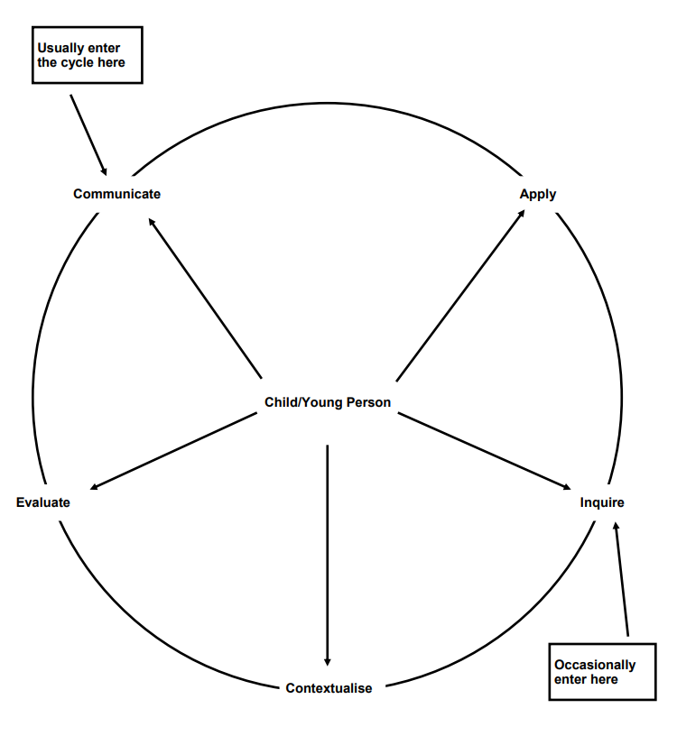
The cycle of enquiry
Apply
How does the concept relate to them and their lives?
Communicate
The children’s own ideas, responses and experiences of the concept.
Evaluate
What is the value of the concept within the religion?
How important is it to me?
Inquire
Unpicking the meaning – the children’s own ideas of the concept – no definitive answer
Contextualise
How is the concept shown within a religion?

Slide 9
Communicate
What is your idea of… ?
What’s your experience of… ?
Who has the same experience as you?
What do you think about … ?
Was there anything you saw in THE RELIGIOUS CONTEXT that has made you think differently?
Apply
How does … affect your life?
What difference does … make to you?
Does anyone agree?
Does anyone disagree?
Is this concept the same for everyone?
Would it be the same for… ?
Will you always think that?
Inquire
What do you think it means?
… could you tell me more?
… any other ideas?
… anything to add?
Why do you think that?
Does anyone agree/disagree? Why?
Has anyone been surprised by anyone’s ideas?
Has anyone changed their minds?
Don’t ask your reliable children to start with – try asking the children who might give you more off the wall answers!
Evaluate
What would the religion be like without the concept?
What is the value of the concept within the religion?
How important is the concept to me?
Contextualise
How is the concept shown within a religion?
Would everyone from that religion agree?
The children are looking at the concept not the whole religion
Questions to use with the cycle

Slide 10
How RE links to other subjects
Natural links with PSHE and P4C
Excellent English links
Can also link with history – eg leaders
Science – eg change
Creative arts
And many other subjects too ...

Slide 11
Useful websites
HIAS RE curriculum site:
http://www.hampshire-reweb.co.uk
Hampshire RE moodle:
http://re.hias.hants.gov.uk

