Slide 1
Hinduism subject booster
Maya Warrier

Slide 2
Main themes in today’s session
Studying Hinduism
Hindu conceptions of the divine
The human-divine relationship
Bhakti or devotion
Image worship

Slide 3
1. Studying hinduism

Slide 4
1. Studying Hinduism: some caveats
Not a ‘religion’ in the conventional sense
Points to bear in mind
  Abrahamic frames of reference do not readily apply to Hindu contexts
  Much of what we teach students about Hinduism comprises generalisations which fail to do justice to Hinduism’s diversity
  Hinduism is best understood as a tradition of orthopraxy (emphasis on correct practice) rather than orthodoxy (emphasis on correct belief)
  ‘What constitutes ‘correct’ practice, in Hinduism, is highly context-sensitive

Slide 5
2. Hindu conceptions of the divine

Slide 6
Hindu conceptions of the divine
Hindus often refer to the concept of ‘Brahman’
What is Brahman?
  An ultimate transcendent reality - ‘God’?
  The ‘Absolute’: unchanging, eternal, omnipresent
  The origin, sustaining power, and end of all things
  The ‘ground of all being’

Slide 7
Two forms of brahman
Hindus also make a distinction between:
  Nirguna brahman (brahman in the abstract sense – without form or quality, beyond all definition)
  Saguna brahman (brahman conceptualised in more tangible terms – with form and definable qualities)

Slide 8
The immanent divine: saguna brahman
Hindus worship the divine in a range of different, immanent forms:
  The different deities: in different Hindu contexts, there are multiple regional variations of the gods and goddesses
  Hindus often treat landscapes, natural features, as infused with divinity and worthy of worship
  Men and women (gurus, spiritual leaders, founders of religious movements), believed to have divine qualities, are often worshipped as sacred beings
Are Hindu traditions:
    Pantheistic?
    Polytheistic?
    Monotheistic? (Lipner: ‘polymorphic monotheism’)
    Monistic/ non-dualistic?
    (We see instances of all of the above)

Slide 9
Atman and Brahman
Hindu thought does not make a distinction between body and soul
Instead it makes a distinction between:
  The gross material body (subject to change)
  The subtle ‘karmic’ body (subject to change)
  The atman (unchanging and eternal)
True knowledge is understood as the knowledge that the self is the atman
  The relationship between atman and brahman in conceptualised in different ways in different philosophical traditions

Slide 10
3. The human-divine relationship

Slide 11
The human-divine relationship
Ideas about the relationship between self and ‘god’ are contained in a range of Hindu texts. The ones most often cited are:
The Upanishads
  These texts speculate (among other things) about the nature of life, consciousness, and the ‘true self’
  They are often referred to as the ‘Vedanta’ (anta: end)
The Bhagavad Gita
  This text, ‘The Song of the Lord’, is a dialogue between a personified god, Krishna, and his cousin, Arjuna; here Krishna reveals to Arjuna the nature of the ‘true self’

Slide 12
Three different interpretations of the upanishads and the gita
There are three main approaches in Hindu textual traditions to the human-divine relationship:
  advaita (non-dualism);
  vishishta advaita (qualified non-dualism);
  dvaita (dualism)
Each was developed by South Indian philosopher-theologians (vedantins), all Brahmins, particularly adept at philosophical exposition

Slide 13
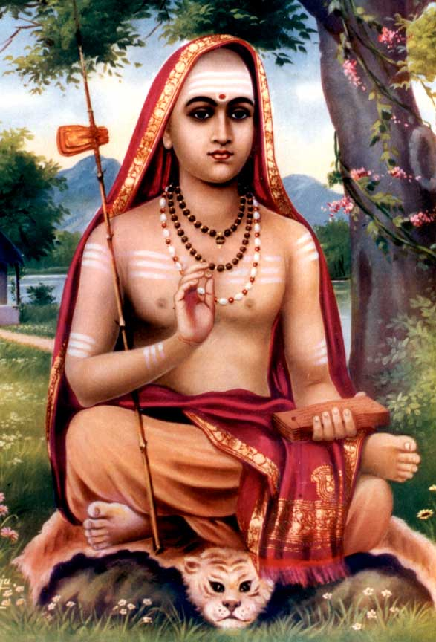
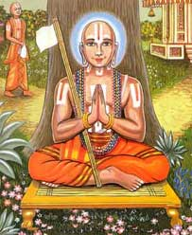
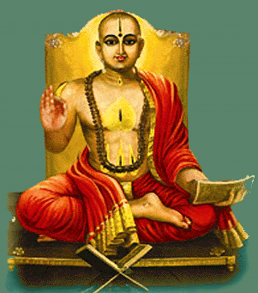
The philosopher-theologians:
Shankara (Adi Shankaracharya) – 8th/9th centuries
Ramanuja (Ramanujacharya) – 11th/12th centuries
Madhava (Madhvacharya) – 13th century

Slide 14
Shankara and Advaita (non-dualism)
Key text: Vivekachudamani (The Crown Jewel of Discrimination) and a commentary on the Bhagavad Gita
  Atman IS Brahman, self IS ‘god’/ ultimate reality/ transcendent consciousness
  There is only one ultimate reality; there are no two, there is no plurality (in the state of enlightenment or pure consciousness)
  The plurality we see around us (maya) is illusory and it ensnares us
  To achieve enlightenment we need to wake from our state of illusion/ delusion

Slide 15
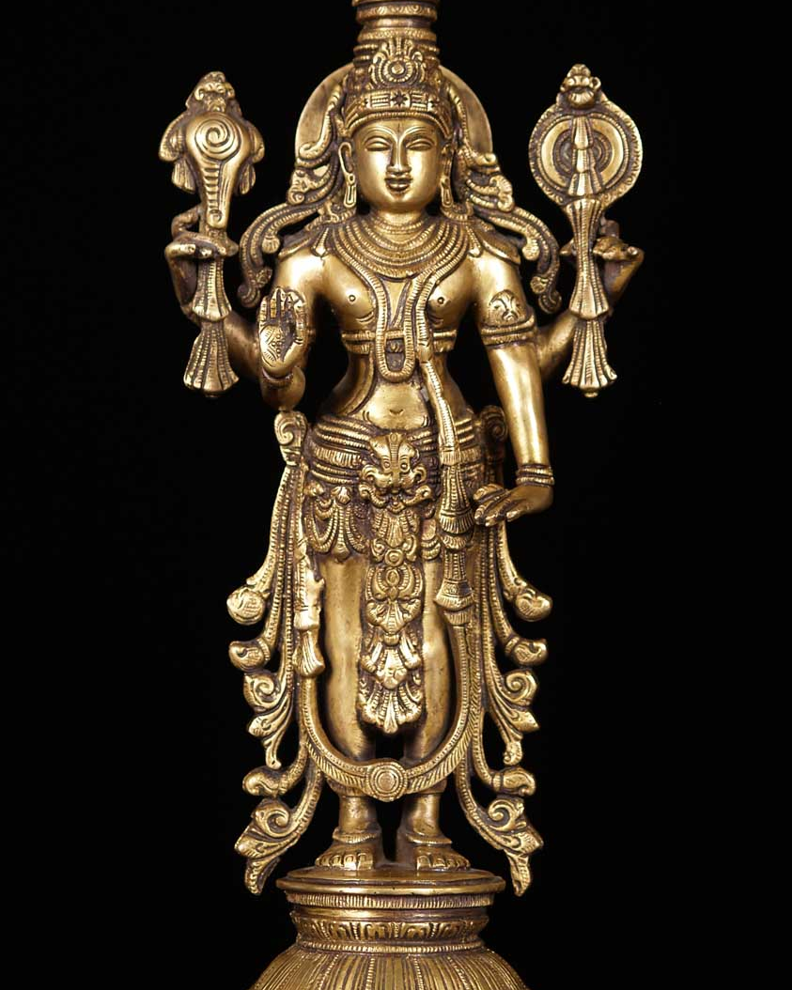
Ramanuja and Madhva
Both focused on saguna brahman (a personified god, in the form of the Hindu great god Vishnu)

Slide 16
Ramanuja and his qualified dualism - vishistadvaita
Key texts: commentaries on the Brahma Sutras and the Bhagavad Gita
  Reality as we understand it is not false – the world is plural, internally qualified/ differentiated; this is the expression of god’s creative power (maya)
  We are not god (Vishnu), we are an aspect of god, just as the sun’s rays are not the sun but an aspect of the sun (but each ray of the sun is like every other)
  Enlightenment and liberation requires not just knowledge of god but also the grace of god

Slide 17
Madhva and dualism (DVAITA)
Key texts: commentaries on the Brahma Sutras and the Bhagavad Gita
  There is complete distinction between god (Vishnu) and self
  Everyday reality is not illusory
  Our different selves are not identical – we are each distinct
  Not all of us are yet worthy of moksha (liberation)
  The only way to strive for liberation from this world is to engage in devotion to, and worship of, god.
  Ultimately liberation is the result of divine grace alone.

Slide 18
4. Bhakti or devotion

Slide 19
Bhakti (devotion)
All three commentators (even Shankara despite his non-dualistic philosophy) valorised the importance of bhakti or devotion to god.
Bhakti in the Bhagavad Gita:
  In the Gita, Krishna(who describes himself as an incarnation of Vishnu) asserts the following:
  9.26 He who offers to me with devotion only a leaf, or a flower, or a fruit, or even a little water, this I accept from that yearning soul, because with a pure heart it was offered with love.

Slide 20
Paths to enlightenment
Bhakti is often seen as one among a range of potential paths towards enlightenment
Three key paths:
  Jnana yoga – the path of knowledge
  Karma yoga – the path of action
  Bhakti yoga – the path of devotion
    Bhakti is often represented as the easiest path; in contemporary Hindu contexts, one can readily recognise a range of different vivid and vibrant expressions of bhakti

Slide 21
Meanings of bhakti
Intense expressive love for, and devotion to, a personified deity
Emphasising the emotions, beauty (aesthetics), stimulation of the senses
Expressed through art forms, rituals of worship, festivals
An expression of mutuality, mingling, sharing between the worshipper and the worshipped

Slide 22
Bhakti Traditions
The great gods:
    Brahma (creator)
    Vishnu (preserver)
    Shiva (destroyer)
    Shakti (female divine energy)
Bhakti traditions in Hinduism
    Vaishnava traditions/ Vaishnavism (the worship of Vishnu)
    Shaiva traditions/ Shaivism (the worship of Shiva)
    Shakta traditions/ Shaktism (the worship of Shakti)
The formation of sampradayas (devotional orders) – each a ‘religion’ in its own right?

Slide 23
5. Image worship: murti puja

Slide 24
5. Image worship
The images:
  Tangible expressions of the intangible
    (though incomplete, inadequate and impermanent)
  Means to an end -- vigraha
  Real embodiment of the deity

Slide 25
Puja – the central devotional ritual
Objects of ritual worship
Places of ritual worship –
    temples (one presiding deity plus lesser deities)
    household shrines (eclectic)
The creation of images -- beauty in idealised form; visual theologies
The consecration of images – installing the life force

Slide 26
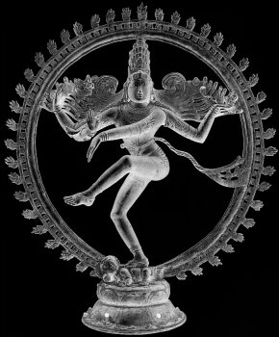
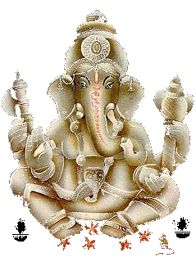
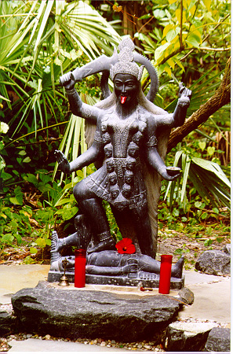
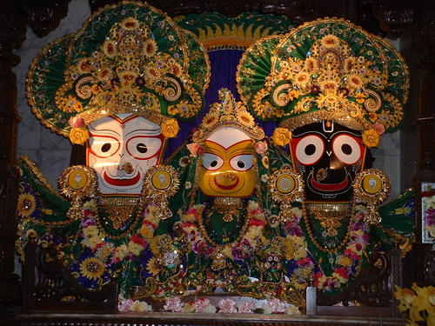
Objects of worship – the sacred image

Slide 27
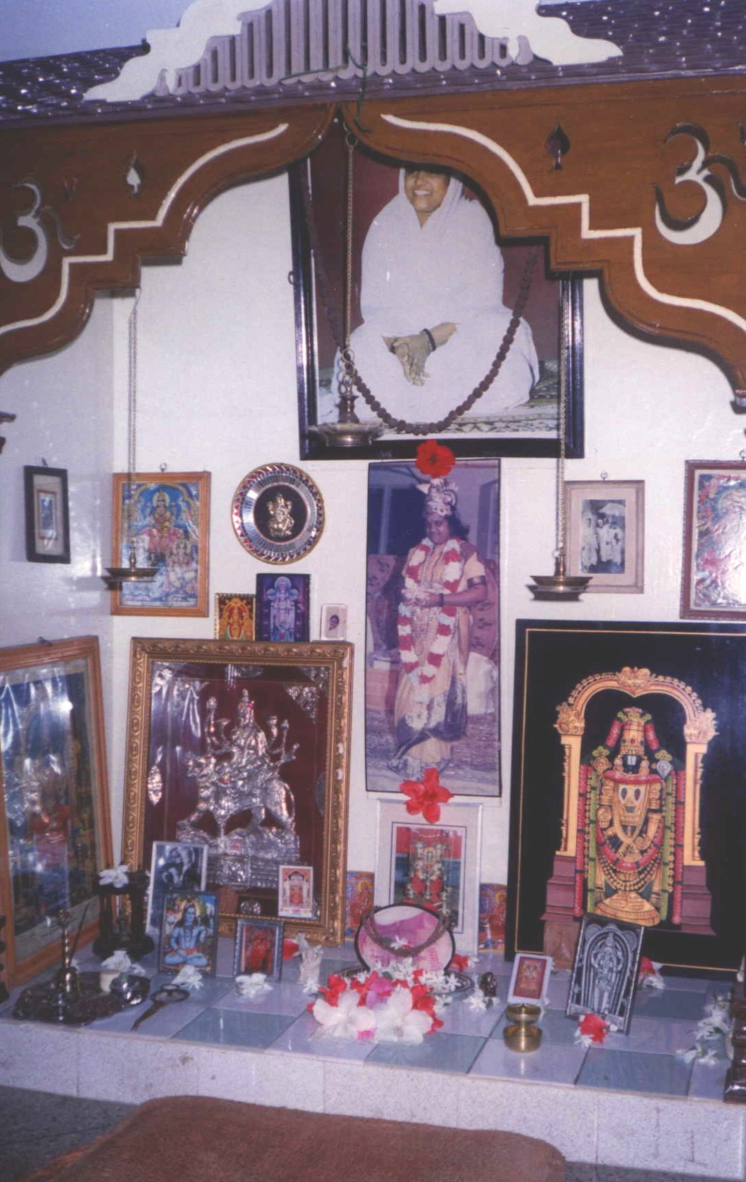
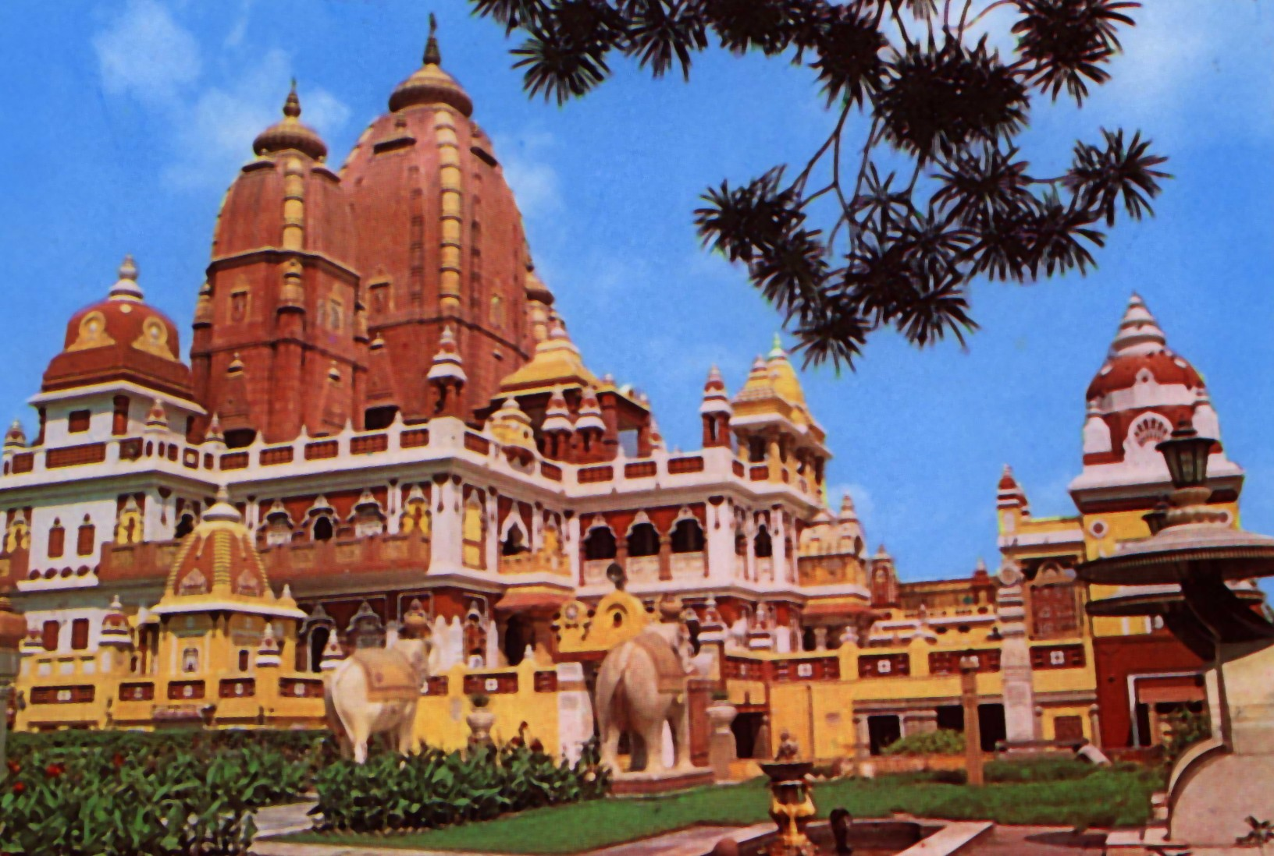
Places of worship: temples, household shrines

Slide 28
The temple context
Temples: abodes of the gods
  Daily temple routines
  Special festivals
Temple authorities – Brahmins
The stages in ritual worship in temples
    the preparatory ritual – purification, resolution, invocation
    the bathing ritual
    the decorating ritual
    the food offering ritual
    the display of lamps
    the distribution of consecrated food (prasad)
    Taking leave of the divine presence

Slide 29
Participating in temple worship
Traditionally not a congregational event
The devotee undergoes purification rituals before entering the temple
Movement – traditionally clockwise – entry into sacred time and space often likened with a return to the womb
‘Taking’ darshan – seeing the divine image
Partaking of the flame, the prasad (consecrated food)

Slide 30
Human-divine interaction
A relationship of interdependence
  Honouring a royal guest; extending hospitality
  Seeking divine protection
A relationship of hierarchy
  The gods: purest of the pure
  Keeping the impure at bay
A relationship of intimacy and mutuality
  The symbolism of the camphor flame: taking the deity unto oneself
  Recharging and renewal

Slide 31
The impermance of the image
Avahana (invocation) and visarjana (dismissal)
The human-divine encounter: concentrated, fleeting, transient
    Symbolising the transience of all creation
Levels of meaning
    Meeting of two corporeal forms – the human body and the divine image
    Meeting of subtle essences: the eternal intangible self (atman) with the eternal divine (brahman – nirguna/ saguna)

