Slide 1
Hope
Why does hope make a difference?

Slide 2
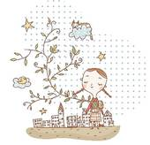
Communicate
What are you hoping for today?
What are you hoping for over the next year?
What are you hoping your life will be like in 10 years time?
What does the concept of hope mean to you?

Slide 3
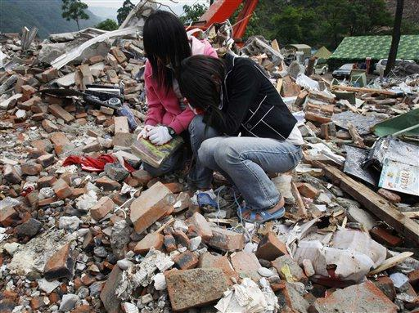
Apply
Imagine you are one of the students shown in the picture. How would your hopes for today, next year and for 10 years time, change?
If you don’t get what you are hoping for, does it stop you from hoping for other things? Why/why not?
Two Chinese students, who survived an earthquake, cry while holding a Harry Potter book belonging to a victim, at a collapsed school in Beichuan China's southwest Sichuan province, Wednesday, May 21, 2008.

Slide 4
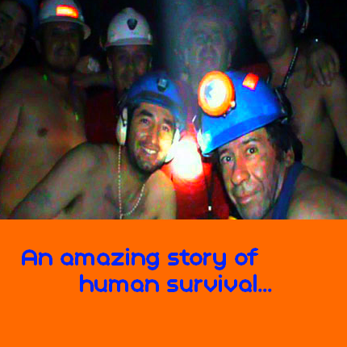
Enquire
The Chilean Miners Rescue
On August 5th 2010, thirty-three men became trapped in a gold and copper mine in San Jose, Chile. The mine caved in, leaving them all trapped.
For an incredible sixty-nine days, they've stayed alive, and relatively sane. Their eyes became accustomed to the darkness, and somehow they've had oxygen to breathe. They were buried 622 metres below ground.
One man is reported to have kept his vitality by running laps. A typographer spent time mapping the area that they were trapped in.
In the beginning, the families were told the rescue would be difficult, if not impossible. Early attempts were thwarted by cave-ins. Morale was low.

Slide 5

The men were trapped in an airless space, without light, stones raining down on them, miserably comforted by the sound of drilling which meant, at least, that someone was trying to save them.
They were trapped for 69 days. Do you think you could have remained hopeful for all that time?
Hope is the emotional state, the opposite of which is despair, which promotes the belief in a positive outcome related to events and circumstances in one's life. It is the "feeling that what is wanted can be had or that events will turn out for the best" or the act of "looking forward to with desire and reasonable confidence" or "feeling]that something desired may happen.

Slide 6
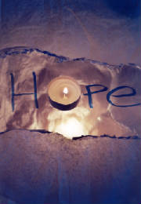
Contextualise
Proverbs 23:18 There is surely a future hope for you, and your hope will not be cut off.
Proverbs 24:20 for the evil man has no future hope, and the lamp of the wicked will be snuffed out.
Isaiah 40:31 but those who hope in the LORD will renew their strength. They will soar on wings like eagles; they will run and not grow weary, they will walk and not be faint.
What do these Bible quotes suggest is the meaning of the concept of hope to Christians?

Slide 7

Christian funeral services
Christians believe that when someone dies, they are judged by God. The righteous go to Heaven and the sinners go to Hell.
Funerals can take place at a church or in a crematorium. The priest will open the service with the following reading:
'I am the resurrection and the life,' saith the Lord; 'he that believeth in me, though he were dead, yet shall he live: and whosoever liveth and believeth in me shall never die.'
Book of Common Prayer 1979
What does this suggest about the meaning of hope to Christians?

Slide 8

After various readings, hymns and prayers is the commendation and farewell. The priest speaks these words: "Let us commend (the person's name) to the mercy of God, our maker and redeemer." The priest then reads a prayer of entrusting and commending.
The committal: this is probably the most solemn moment of the service. At a burial, this is when the coffin is lowered into the grave. At a cremation, the curtains are closed around the coffin. "We therefore commit (his or her) body to the ground; earth to earth, ashes to ashes, dust to dust; in the sure and certain hope of the Resurrection to eternal life."
How does this develop your understanding of the Christian concept of hope?

Slide 9
Discernment (e-valuate – where we look for value)
Why does hope make a difference for someone leading a Christian way of life?
Is hope of value for my life?

