Slide 1
SUKKOT
“‘So beginning with the fifteenth day of the seventh month, after you have gathered the crops of the land, celebrate the festival to the Lord for seven days; the first day is a day of rest, and the eighth day also is a day of rest. On the first day you are to take choice fruit from the trees, and palm fronds, leafy branches and poplars, and rejoice before the Lord your God for seven days. Celebrate this as a festival to the Lord for seven days each year. This is to be a lasting ordinance for the generations to come; celebrate it in the seventh month. Live in booths for seven days: All native-born Israelites are to live in booths so your descendants will know that I had the Israelites live in booths when I brought them out of Egypt. I am the Lord your God.’”
Leviticus 23

Slide 2
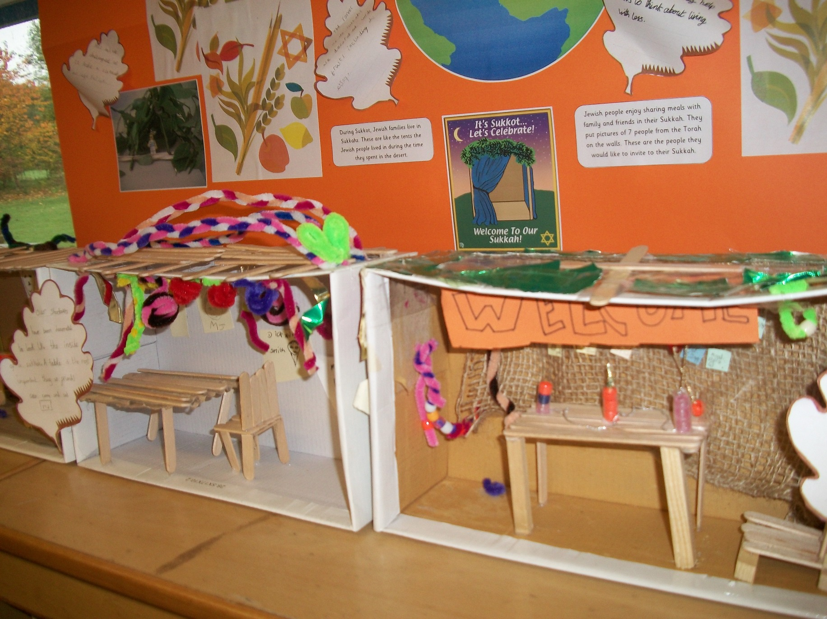

Slide 3
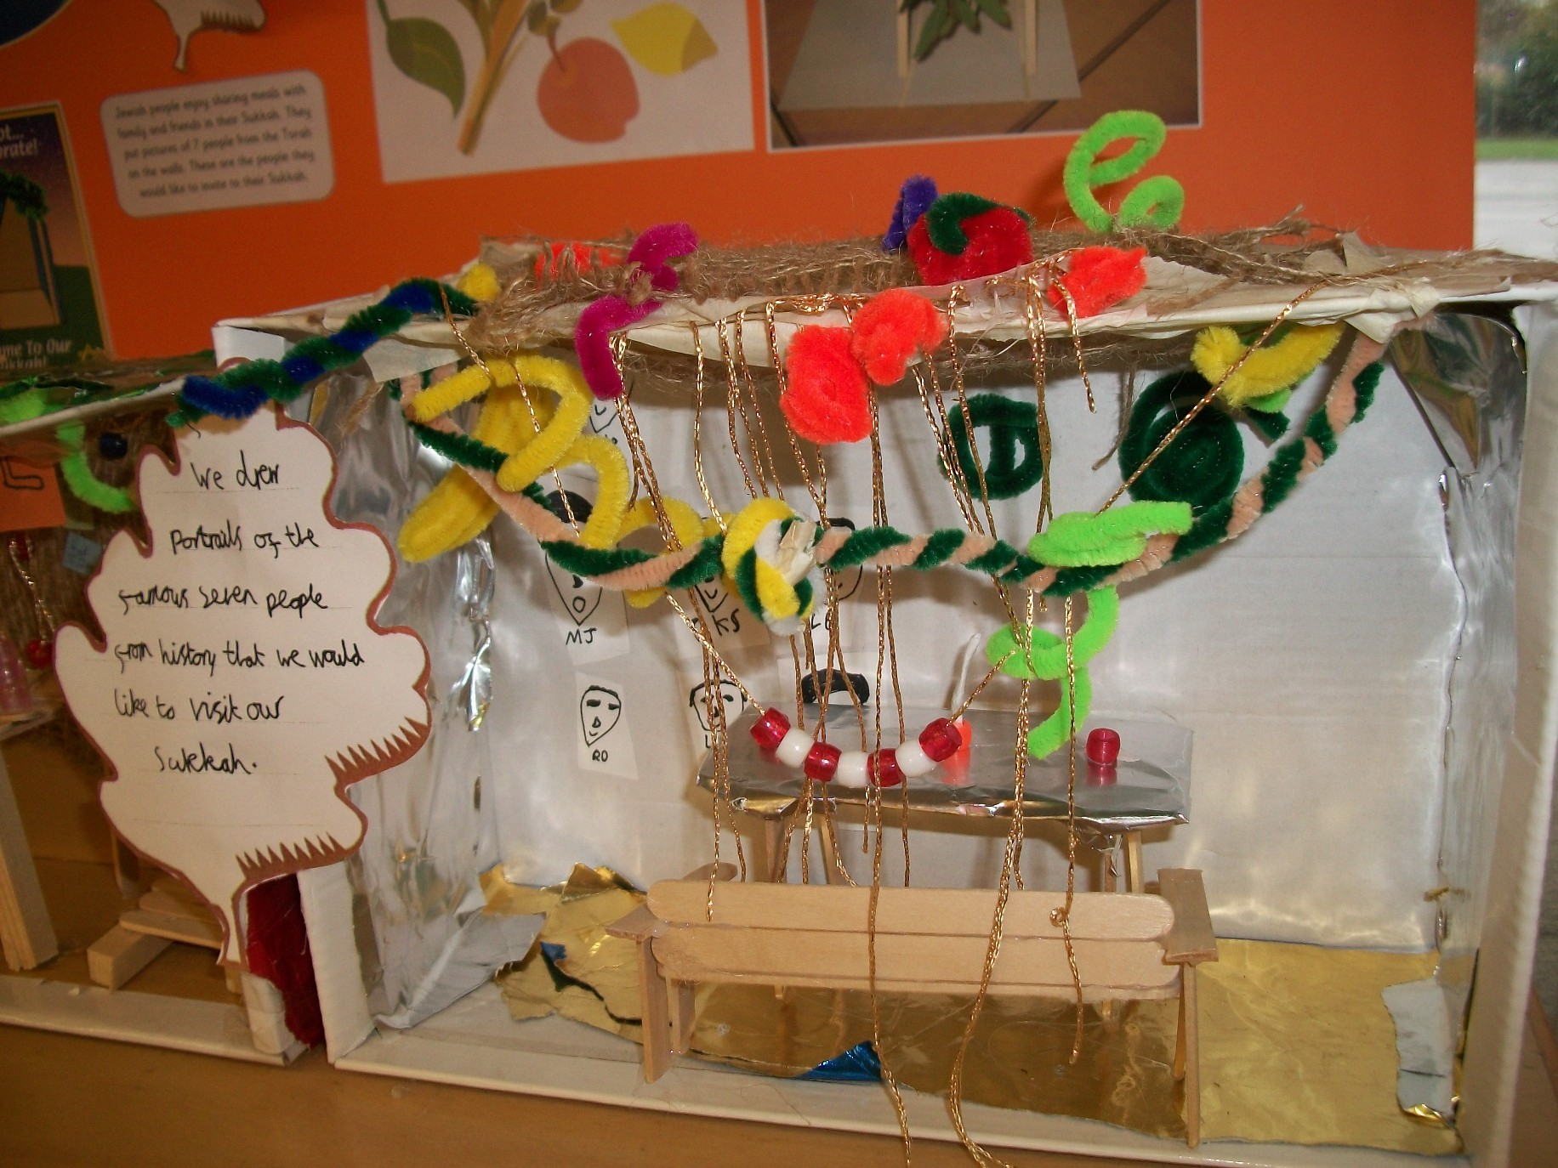

Slide 4
The word sukkah means huts (some translations of the bible use the word booths), and building a hut is the most obvious way in which Jews celebrate the festival.
Every Jewish family will build an open air structure in which to live during the holiday. It must have a roof of branches and leaves, through which you can see the sky, and that it should be a temporary and flimsy thing.
The Sukkot ritual is to take four types of plant material: an etrog (a citron fruit), a palm branch, a myrtle branch, and a willow branch, and rejoice with them. (Leviticus 23: 39-40.) People rejoice with them by waving them or shaking them about.

